Slide 1
Management - Definition
HEROLD KOONTZ:
“Management is the art of getting things done through and with people in formally organised groups. It is the art of creating an environment in which people can perform and individuals could co-operate towards attaining of group goals”

Slide 2
DEFINITRION
Louis Allen : “ Management is what a manager does”
Hentry Fayol : To manage is “ to forcast and plan, to organize, to command, to coordinate, and control.”

Slide 3
NATURE OF MANAGEMENT
Management is a group activity
Management is a Factor of production
Management is an Universal Process
Management is Goal-oriented
Management is a Social Science
Management is a Dynamic Function
Management is a Profession
Management is a Multi-disciplinary Subject
Management is a System of Authority
Management is a Distinct Entity

Slide 4
MANAGEMENT SKILLS
Technical Skill
Human Skill
Conceptual Skill
Other Skill
Setting Objectives
Proper Planning
Sound Organization
Proper financial Planning
Location and layout of plant
Marketing system
Research
Dynamic Leadership

Slide 5
MANAGERIAL FUNCTIONS
Planning
Organising
Staffing
Directing
Controlling

Slide 6
PLANNING
Forecasting, Decision-Making, Strategy formulation
Policy-making, Programming, Scheduling
Budgeting, Problem-Solving
Innovation, Investigation and Research

Slide 7
ORGANISING
Functionalization, Divisionalisation,
Departmentalisation, Delegation, Decentralisation, Activity Analysis, Task allocation
STAFFING
Manpower planning, Recruitment, Selection,
Training, Placement, Compensation, Promotion, Appraisal

Slide 8
DIRECTING
Supervision, Motivation, Communication, Leadership, Activating.
CONTROLLING
Fixation of Standards, Recording, Measurement, Reporting corrective Action

Slide 9
MANAGERIAL AND OPERATIVE FUNCTIONS
Managerial Function /
STEPS IN MANAGEMENT PROCESS Operative Function
Planning 1. Production
Organising 2. Marketing
Staffing 3. Purchasing
Directing 4. Financing
Controlling 5. Personnel

Slide 10
MANAGERIAL FUNCTIONS AND MANAGERIAL LEVELS
TOP MANAGEMENT
MIDDLE MANAGEMENT
SUPERVISORY MANAGEMENT
Planning
Organising
Staffing
Directing
Controlling

Slide 11
ROLES AND SKILLS OF MANAGERS
1. Knowledge of Organization 7. Ability to secure Co-
operation
2. Technical Knowledge 8. Ability to judge
people
3. Administrative ability 9. Leadership qualities
4. Ability to instruct and inspire 10. Social Sensibility
5. Ability to Communicate 11. Physical qualities
6. Ability to listen 12. Other qualities
(Avoid dispute, Human relations,
right decisions aitright times etc.,)

Slide 12
EVOLUTION OF MANAGEMENT THOUGHT
F.W. Taylor
Hentri Fayol
Elton Mayo
Peter F. Drucker

Slide 13
F(Frederick). W.(Winslow) TAYLOR (1856 – 1915)
He is a Father of Scientific Management
He defined management as “ the art of knowing exactly what you want men to do and seeing that they do it in the best and cheapest way”

Slide 14
PRINCIPLES OF MANAGEMENT
Determining One Best Method of Performing Each Task
The Scientific Selection and Education of Workers
Spirit of Friendly Co-operation between Management and Workers

Slide 15
Mechanisms
Time and Motion Study
Functional Foremanship
Standardisation of Tools and Equipment
Differential Piece Rate System
Establishing a Planning Department

Slide 16
HENTRY FAYOL (1841-1925)
14 PRINCIPLES
Division of Work
Authority and Responsibility
Discipline
Unity of Command
Unity of Direction
Scalar Chain

Slide 17
Subordination of Individuals Interest to the General Interest
Remuneration
Centralisation
Order
Equity
Stability to Tenure of Personnel
Initiative
Esprit de corps

Slide 18
ELTON MAYO (1880-1949)
Hawthorne Studies during 1924-1932
The Illumination Experiments
Relay Assembly Test Group
Mass Interviewing Programme
The Bank Wiring Observation Group

Slide 19
FINDINGS OF H.EXPERIMENTS
Human factor is the most important in Organizations
At the Work Place, Workers Create Groups
Informal Leadership
Group Standards is important

Slide 20
SUMMARISES
Productivity is not an engineering function
A true concern for people buys rich dividends
Management Skills and Technical Skills are necessary for a Successful leader
Good Interpersonal and Intergroup relationship among the people

Slide 21
PETER F. DRUCKER
He is a Professor, management consultant and a Great management Thinker
INNOVATION OF THINKING IS MUST FOR ACHIEVING THE MANAGEMENT TASK
Decentralisation of Functions (Delegation of Authority and Responsibility)
MBO is regarded as a major contribution of Drucker

Slide 22
THREE TASKS
Setting specific purposes and mission for the institution
Making work productive and the work achieving
Managing social impacts and social Responsiplities

Slide 23
Peter F. Drucker Main Contributions
Nature and Role of Management
Manager’s Job
Federal Decentralisation
Organization Structure
Decision – Making
Management Development
Futurity

Slide 24
Management By Objective
Process of MBO
Goal setting
Action plan
Final review

Slide 25
Benefits of MBO
Clear goals
Control easier
Objective appraisal
Motivational force
Morale

Slide 26
Limitations of MBO
Time consuming
Increases paper work
goal setting problems
Organisational problems

Slide 27
MANAGEMENT: A SCIENCE OR AN ART?
Management as a science
A science may be defined as “ representing knowledge gathered by observation and experiment, critically tested, systematised and brought under general principles”
Identification of the problem
Scientific inquiry
Choice of the best available alternative

Slide 28
Rigorous control procedure (Correct decision)
Validity of Principles (Solve the problem)

Slide 29
Management as an art
Past Experience
Common Sense
Managerial Skills
Human Understanding

Slide 30
Management is Both – a science and an Art

Slide 43
FUNCTIONAL AREAS OF MANAGEMENT

Slide 49
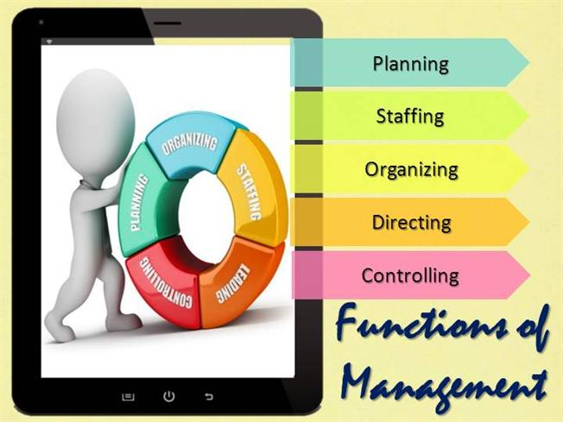

Slide 52
